Slide 1
Week 10

Slide 2
Updates
Quiz 4 10/28
Lab 07 - due Thursday 10/28 (due date moved)
Lab 08 - due Friday 11/5
Programming Contest!!!
This Saturday, 10/30
8:30 AM to 2:00 PM
Food provided
1% extra credit towards overall course grade
Participation = showed up to check in
Sign up today! https://forms.office.com/Pages/ResponsePage.aspx?id=XdZGXFzuE0WM1K-Y0V5oM4iIv7QshFxJv2ncxUvcZKRUODJFN1dORVpOMVRVMlVMT1VKWENYUUFEWi4u

Slide 3
Filesystem Knowledge Wrap Up

Slide 4
Filesystems
The structure and logic rules used to manage the groups of data and their names is called a "file system.“
Without a file system, data placed in a storage medium would be one large body of data with no way to tell where one piece of data stops and the next begins
$ strings block_device

Slide 5
Filesystem types
Fourth extended filesystem (ext4)
Unix FS + Fast FS = ext2
ext3 added journaling (data integrity + faster booting)
ext4 supported larger files and more subdirectories
B-tree filesystem (Btrfs)
Newest, on track to replace ext4
FAT filesystems by Windows - vfat (up to 4GB), exfat (> 4GB)
NTFS - modern Windows default FS
XFS - high performance file system (RedHat / enterprise)
HFS+ - Apple standard
ISO 9660 - CD-ROM standard
Notes:
https://www.howtogeek.com/443342/how-to-use-the-mkfs-command-on-linux/

Slide 6
Journaling Filesystems
Journaling is an important concept in file systems.
The file systems records the pending file writes to a journal.
As each file is written to, the journal is updated, and the pending write records are updated.
This allows the file system to repair broken, partially written files that have occurred due to a catastrophic event such as a power cut.
Some of the older file systems do not support journaling.
Those that don’t, write to the disk less frequently because they don’t need to update the journal.
They may perform faster, but they are more prone to damage due to interrupted file writes.
Notes:
https://www.howtogeek.com/443342/how-to-use-the-mkfs-command-on-linux/

Slide 7





Make a filesystem
# mkfs -t fs_type blockdevice_or_file
`mkfs` determines blocks in device and sets defaults
On success, mkfs prints output that includes details about the superblock
Notes:
https://www.howtogeek.com/443342/how-to-use-the-mkfs-command-on-linux/

Slide 8
Mounting a filesystem
Need to know:
Filesystem’s device / location
Filesystem type
Mount point - place in system directory structure where filesystem will be attached
/mnt/ is a common “playground” for mounting filesystems…
# mount -t type device mountpoint
# mount -a
Useful is editing /etc/fstab, where long term “please mount” details are listed

Slide 9
Unmounting a filesystem
Kernel doesn’t immediately write out changes to a disk - changes are stored in RAM until there is a “good time” (or you hit save)
The sync command will also synchronize with the disk
Kernel may also cache a file to RAM so it doesn’t have to go back to disk
On `umount` = unmount, kernel synchronizes with disk
This is also why hitting “eject” is important and waiting for the system to indicate it is finished is a big deal

Slide 10
Terminology of a filesystem
Superblock: file system metadata and defines the file system type, size, status, and information about other metadata structures (metadata of metadata).
dentry is the glue that holds inodes and files together by relating inode numbers to file names. Also maintains a relationship between directories and their files
inode exists in, or on, a file system and represents metadata about a file
information about ownership (user, group), access mode (read, write, execute permissions), file type, and the data blocks with the file's content
file is a block of logically related arbitrary data
Notes:
https://unix.stackexchange.com/questions/4402/what-is-a-superblock-inode-dentry-and-a-file

Slide 11


What we see
`ls`, `tree`, `cd`

Slide 12

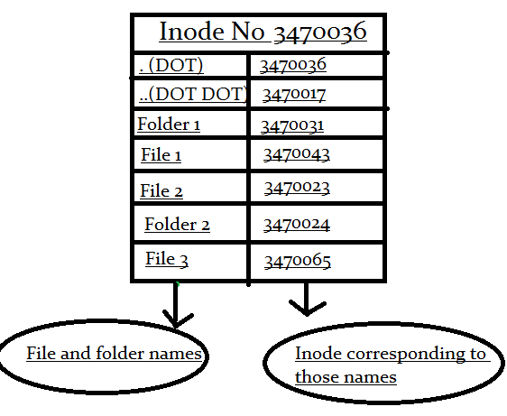
What it really is
Pool of data blocks where you can store data
Database system (dentry) that manages the data pool using the inode data structure
Notes:
https://www.slashroot.in/inode-and-its-structure-linux
https://practice.geeksforgeeks.org/problems/explain-the-structure-of-inode-table
https://en.wikipedia.org/wiki/Inode_pointer_structure#/media/File:Ext2-inode.svg

Slide 13
inodes
Internally, your OS doesn't care about your file names
Linux uses inodes
Windows uses file-IDs
Number of inodes != disk size
How many i-nodes are taken:
$ df –ih /
Disk size (blocks taken)
$ df -h /

Slide 14
inodes
I-nodes capture metadata about the file
Size
Permissions
Date modified
Where it resides on drive (which blocks)
Every file references an inode and vice-versa
$ ls -li
First column is the inode
$ stat filename

Slide 15

Linking
"C:\Users\kduncan\OneDrive - Wright State University\Teaching\CEG2350"
Hard link
Inode is associated with multiple file names
All files hardlinked point to the same inode & the same blocks on the disk
A change to a file changes the blocks
Soft link
A file has a inode, but it points to the inode of another file (not to blocks on a disk)
Removing the symbolic link has no effect on the real files existence
Copy
Files exist with unique inodes written to unique blocks
Move
New file name associated with inode

Slide 16
Linux - creating links
Create a file
$ ln target link_name
Check stat
$ ln --symbolic target link_name
Check stat
What type of path?
Check out --relative
What’s the problem?
Notes:
https://coffeewithbytes.com/blog/hardlink_softlink/

Slide 17
Windows – Shortcuts & Links
Symbolic links in Windows are "shortcuts"
Right click on a file to create Shortcut
Powershell:
Symbolic link
New-Item -ItemType SymbolicLink -Path "Link" -Target "Target“
Hard link
New-Item -ItemType HardLink -Path "Link" -Target "Target"
Notes:
https://winaero.com/create-symbolic-link-windows-10-powershell/

Slide 18

Filesystem UUID
Device names can change
Use instead their universerally unique identifier (UUID)
# blkid
List of devices and corresponding filesystems and UUIDs

Slide 19
Filesystem mount options
-r : mount filesystem in read only mode
-t : filesystem type
exec / noexec - enables or disables execution of programs on the filesystem
suid / nosuid - enables or disables setuid programs
uid - treat files as though given uid is owner
ro - mount filesystem in read only mode (long form)
rw - mount filesystem in read-write mode

Slide 20
/etc/fstab (filesystem table)
Entries contain mounting information
UUID or device
Mount point
Filesystem type
Options (long options, comma separated)
Backup info for dump command (archived, set to 0)
Filesystem integrity test order
1 for root filesystem
2 for all others
0 to disable bootup check (this is the usual)

Slide 21
Sizing up
$ df
Filesystem disk space usage
Filesystem device, 1K-blocks (capacity in blocks of 1024 bytes), used, available, used percentage, mounted on (the mount point)
$ du
File space usage. Find out what is hogging disk space

Slide 22
inodes vs blocks
There are two resources that a file system provides to the user: blocks (for data) and inodes (for file metadata).
Each file consumes one inode
File data is stored in data blocks on the disk
Assuming there are no directories, it is possible for a user to exceed his or her inode quota without using any blocks by creating all empty files.
Infinite use of `touch` command
It is also possible for a user to use only one inode yet exceed his or her block quota by simply creating one file large enough to consume all the data blocks in the user's quota.
Notes:
https://docs.oracle.com/cd/E19455-01/805-7229/sysresquotas-3/index.html

Slide 23
Available blocks
How does filesystem know which blocks are open for data storage?
Block allocation map / block bitmap
0 and 1 of free or open for each block

Slide 24
Repairing a filesystem
(or at least trying)
# fsck device
Filesystem must be unmounted otherwise you can cause the conflict you are trying to fix!

Slide 25
Filesystem Demos
Create a filesystem on a partition in Windows
Create a filesystem on a partition on a USB drive
Create a filesystem on a partition in AWS
Create a filesystem using a file
Introduce dd

Slide 26
dd
$ dd if=/dev/zero of=new_file bs=1024 count=1
If = input file (default is STDIN)
Of = output file (default is STDOUT)
Bs = block size - read and write x bytes of data at a time
Count = number of blocks to copy
Don’t copy “all” of /dev/zero - copy a block of it

Slide 27
Special purpose Filesystems
/proc/
Process. Each numbered directory = a process. Files inside represent aspects of the process. Contains other kernel / hardware info in files
/tmpfs/
Use RAM and swap as temporary storage. Could cause interesting snags
Squashfs
Read only filesystem where content is stored in compressed format and extracted on demand
Overlay
Merges directories into composite. Containers use these ☺

Slide 28
Securely Deleting Info from Disk
https://www.howtogeek.com/425232/how-to-securely-delete-files-on-linux/

Slide 29
File Locks
Special frame attached to the file, contains a bunch of info, but most usefully:
Tells if the file is open, closed, being deleted, etc.
Protects the system from potentially disastrous situations, such as the case of one process deleting a file when another process is using it
Why the Eject button exists
Need to tell FS to wrap up updates (journaling)
Show swap files and temp files

Slide 30
Windows Mounts
In Windows, devices are usually auto-mounted
Drive letters
Specifies paths to different devices
C: is an assumed default primary partition
Could use different letter, applications might be upset
Trivia: What happens when you’re out of letters?
Nothing; Windows will do nothing with the next drive
Notes:
https://www.howtogeek.com/426852/why-does-windows-still-use-letters-for-drives/
https://www.reddit.com/r/answers/comments/a0qjtp/on_windows_if_your_computer_has_more_than_26/

Slide 31
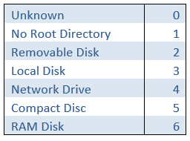
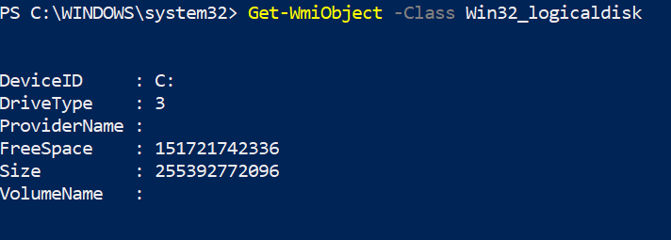
Windows Space Tools
Via file explorer (no shame)
Disk Management
Powershell
Get-WmiObject -Class Win32_logicaldisk
Notes:
https://mcpmag.com/articles/2018/01/26/view-drive-information-with-powershell.aspx

Slide 32
Case: Freshly built PC
When installing the OS, you can determine partition sizes for the data and operating system
Installer will use the partition table that matches your UEFI BIOS (GPT)
Installer will create partitions for special use (if needed)
Note: this means during install, you could choose to truncate how much space is associated with the OS / files
Notes:
https://www.linuxtechi.com/ubuntu-18-04-lts-desktop-installation-guide-screenshots/
https://pureinfotech.com/create-custom-partition-install-windows-10/

Slide 33
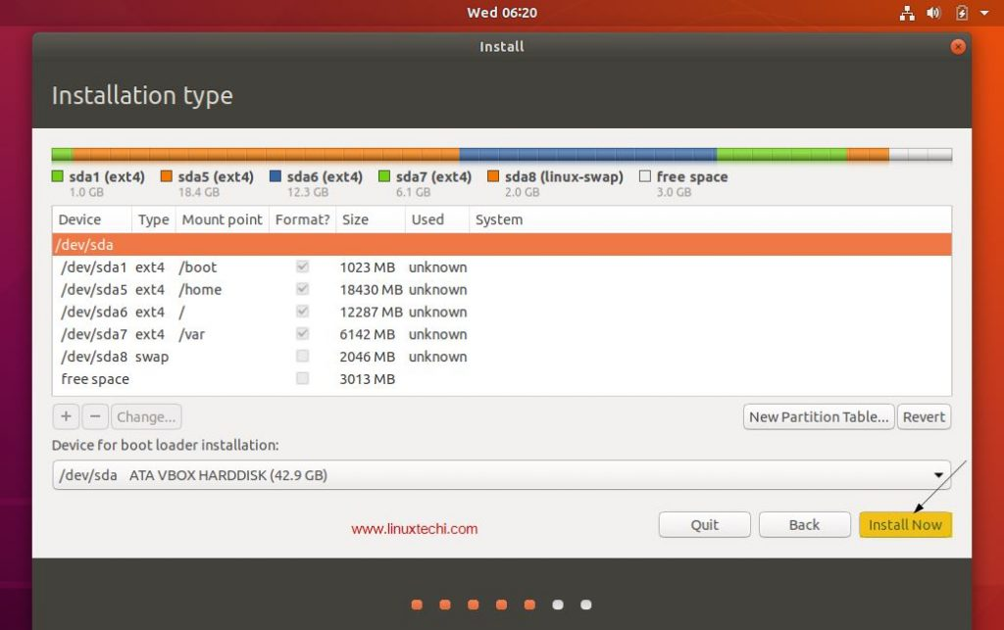
Linux: Installation Partition Example

Slide 34
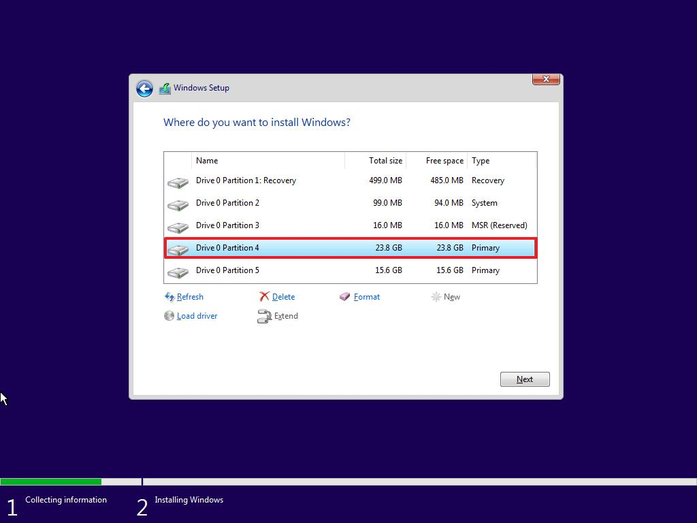
Windows: Installation Partitioning

Slide 35
Case: Assume OS is installed, adding disk for more storage
Need to create a partition table, one or more partitions, and put a filesystem on the partition(s)
If using Linux, need to mount the device & add to /etc/fstab/
If Windows, assign drive letter when making partitions, automounts

Slide 36
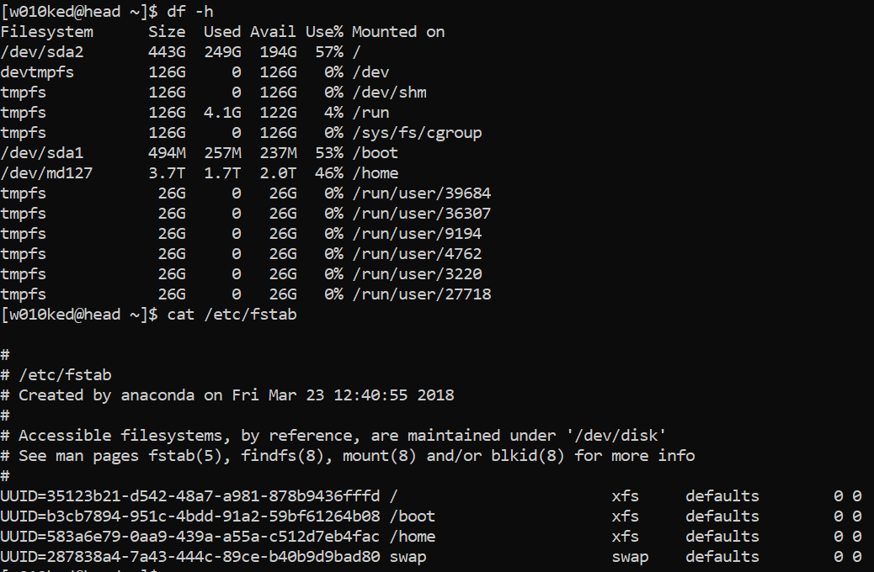

Slide 37
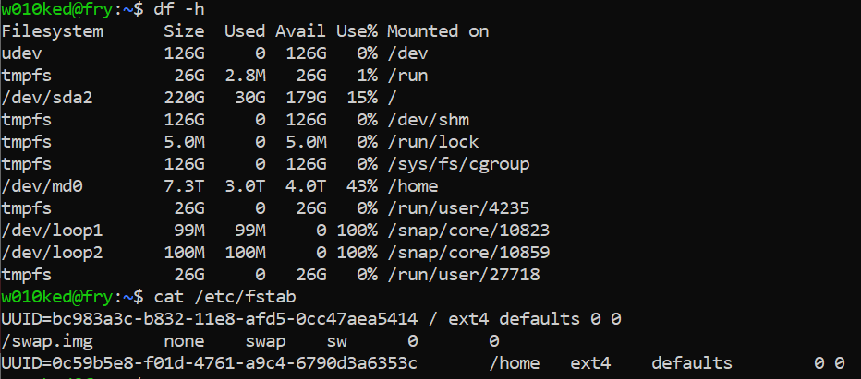

Slide 38
Into init

Slide 39
Mega review diagram
Up until now, we have said the kernel gets loaded into RAM, then ta-da! The OS appears.
Now to discuss what happens after the kernel says systems are go…
$ dmesg # print or control the kernel ring buffer

Slide 40

Kernel -> init -> user space
Kernel maintains information about each process by giving each a unique PID (process id)
Kernel keeps track of the memory assigned to each process, as well as the processes’ readiness to resume execution.
Like files, processes also have owners and user IDs, effective user IDs, and so on.
/etc/passwd and pseudo-users
Init is the first process the kernel triggers (PID 1)
Init then starts all units configured to be started by init
/sbin/init - sbin is a system level executables (generally need root)

Slide 41

Processes and process org
Process contains:
memory context
priority
which dictates how much time the CPU allocates the process
Process ID (PID)
The init process has PID 1
Every process has a parent
Running programs create processes
Programs can be compiled code (“Binaries”) or scripts
Notes:
https://harithj.medium.com/processes-in-linux-dce78e03172e

Slide 42

systemd
Init was great, but needed modernizing. Upgraded to systemd, which is the init process + more features
on-demand starting of daemons / units
$ ls /etc/systemd/system/
mount and automount point maintenance
$ cat /etc/fstab
snapshot support
Status of a service (a webserver would say running)
$ systemctl status unit
Let’s scope what we care about…
Notes:
https://www.linode.com/docs/guides/what-is-systemd/
https://documentation.suse.com/sles/15-GA/html/SLES-all/cha-systemd.html
https://www.freedesktop.org/software/systemd/man/systemd.automount.html
https://blog.fpmurphy.com/2013/09/systemd-snapshots.html

Slide 43
More reading on systemd
https://www.section.io/engineering-education/understanding-systemd/
https://www.linode.com/docs/guides/what-is-systemd/
https://linoxide.com/linux-systemd/

Slide 44
systemctl
systemd – service manager. Interface with systemctl
$ systemctl list-units – lists active services
$ systemctl list-sockets – lists sockets in memory
Systemctl can be used to control services – most common controls:
status
start
stop
reload – reloads configuration files
restart
Notes:
https://www.cyberciti.biz/faq/systemd-systemctl-view-status-of-a-service-on-linux/

Slide 45
journalctl
Query the systemd journal - with no parameters, this is the journal since the beginning of time (first boot)
$ journalctl --since “1 hour ago”
$ journalctl -- since “YYYY-MM-DD HH:MM:SS” --until “YYYY-MM-DD HH:MM:SS”
$ journalctl –u SERVICE
Try tab-complete on the service
Look for journal entries for boot (-b), ssh, apache
https://www.loggly.com/ultimate-guide/using-journalctl/
Notes:
https://www.loggly.com/ultimate-guide/using-journalctl/

Slide 46
Looking at Processes
$ ps
Processes attached to your terminal
$ ps a
Processes attached to your user
$ ps au
Processes attached to your user with common information columns
$ ps ao ppid,pid,command,user,tty,stat
What do the columns mean?

Slide 47
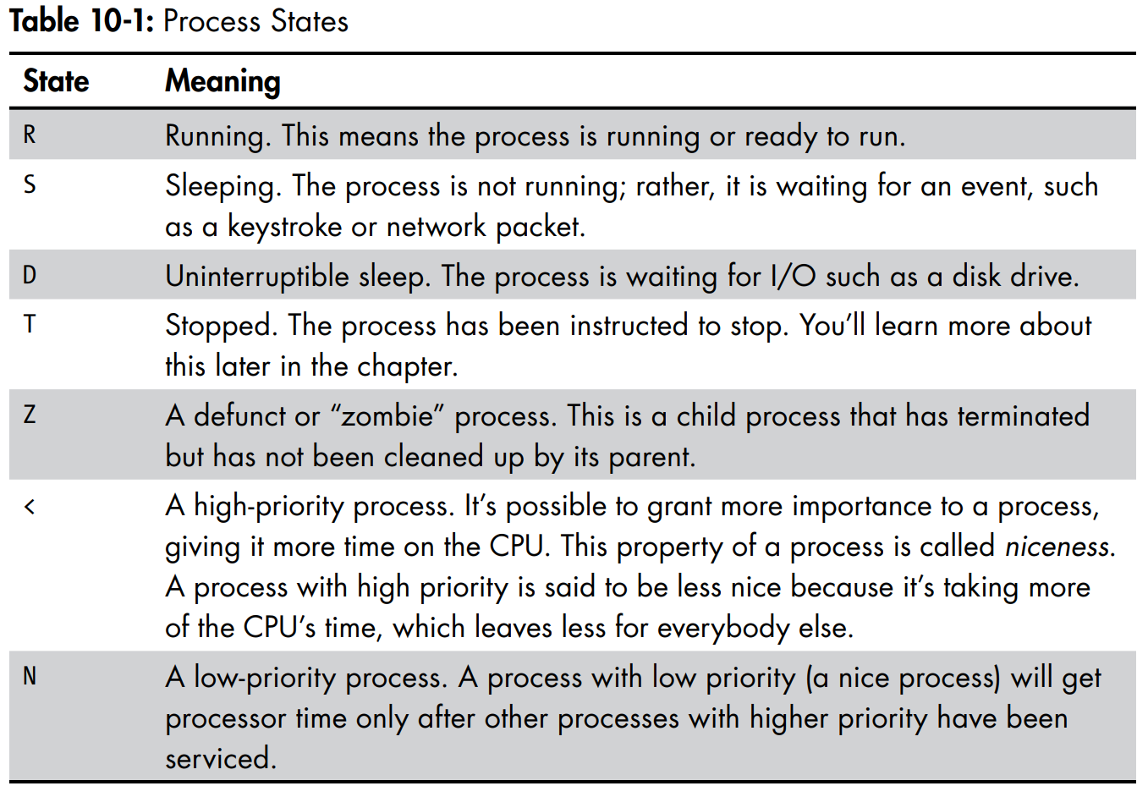


Process States
Notes:
Linux Command line pg 132

Slide 48



System Calls you know
In a program:
Reading files
Write content to files
File openers, file descriptors, etc.
Using a program:
Getting multiple instances of the same thing
I can open many word documents
I can make many SSH connections to the AWS system
These are unique processes that can operate independent of eachother

Slide 49

System Calls
programmatic way in which a computer program requests a service from the kernel of the operating system it is executed on
fork
A parent process uses fork to create a new child process. The child process is a copy of the parent. After fork, both parent and child executes the same program but in separate processes.
exec
Replaces the program executed by a process. The child may use exec after a fork to replace the process’ memory space with a new program executable making the child execute a different program than the parent.
exit
Terminates the process with an exit status.
wait
The parent may use wait to suspend execution until a child terminates. Using wait the parent can obtain the exit status of a terminated child.
Notes:
https://www.geeksforgeeks.org/introduction-of-system-call/

Slide 50
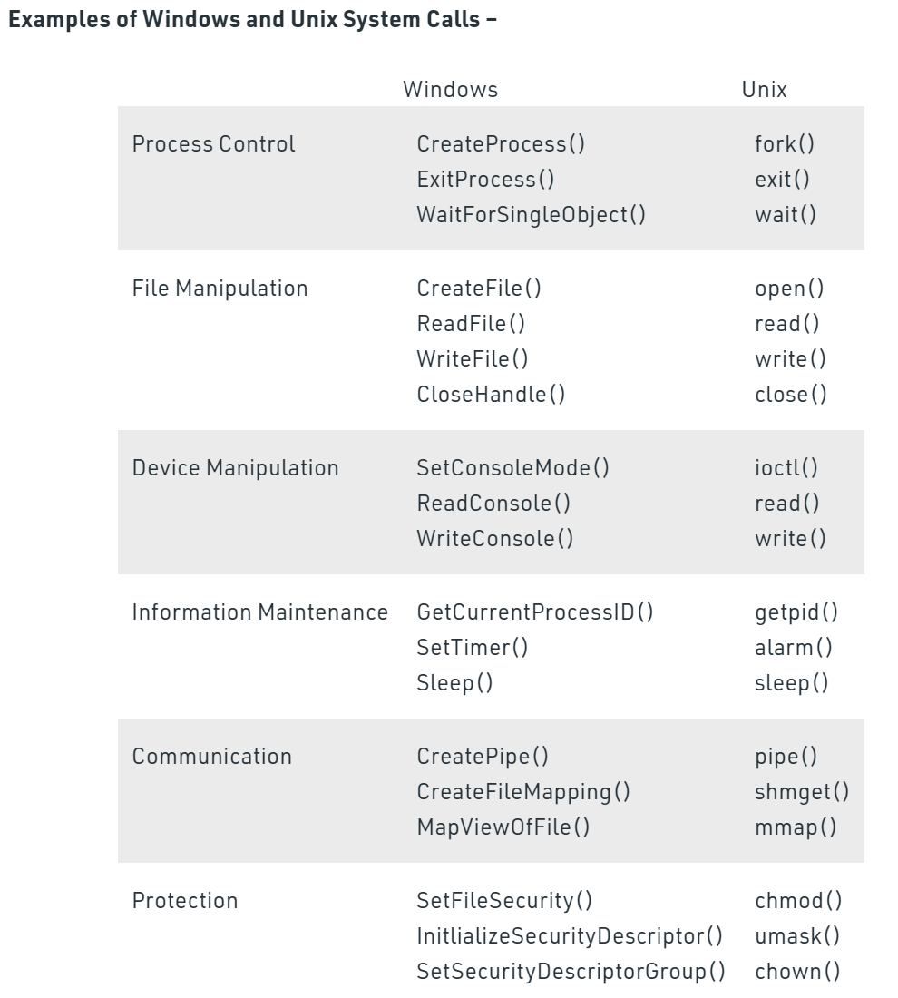
System Calls to note
Notes:
https://www.geeksforgeeks.org/introduction-of-system-call/
https://www.guru99.com/system-call-operating-system.html

Slide 51
Process control resources
https://www.guru99.com/system-call-operating-system.html
http://www.it.uu.se/education/course/homepage/os/vt18/module-2/process-management/
https://www.geeksforgeeks.org/difference-between-process-parent-process-and-child-process/
http://www.cs.iit.edu/~cs561/cs450/fork/fork.html

